Slide 1
Urllib 라이브러리

Slide 2
웹 문서 불러오기
>>> import urllib.request
>>> req=urllib.request
>>> req.urlopen("http://wikidocs.net/") #웹페이지 불러오기
<http.client.HTTPResponse object at 0x02FF1670>

Slide 3
웹서버의 정보 받아오기(get)
>>> d=req.urlopen("http://wikidocs.net/")
>>> status=d.getheaders()
>>> for s in status
>>> for s in status:
print(s)
('Server', 'nginx/1.4.6 (Ubuntu)')
('Date', 'Tue, 06 Feb 2018 02:10:09 GMT')
('Content-Type', 'text/html; charset=utf-8')
('Transfer-Encoding', 'chunked')
('Connection', 'close')
('Vary', 'Cookie')
('Set-Cookie', 'sessionid=gx7dpuruswmvladvomn1rdjm05pplba7; expires=Tue, 20-Feb-2018 02:10:09 GMT; HttpOnly; Max-Age=1209600; Path=/')
>>>

Slide 4
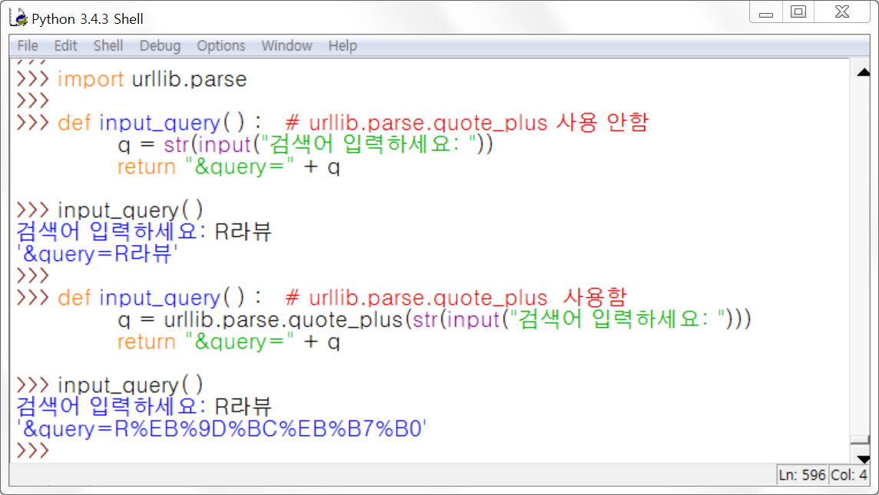
웹페이지 한글 주소 인코딩하기
Notes:
import urllib.parse
def input_query(): #urllib.parse.quote_plus 사용 안함
q=str(input("검색어를 입력하세요:"))
return "&query="+q
input_query()
def input_query(): #urllib.parse.quote_plus 사용함
q=urllib.parse.quote_plus(str(input("검색어 입력하세요:")))
return "&query="+q
input_query()

